Slide 1
^{DSI Capstone} ^{Kick Off}
Kick off
Sept 23, 2022

Slide 2
Overview
Team Introduction
Project Overview
Timeline and Deliverables
Q&A

Slide 3



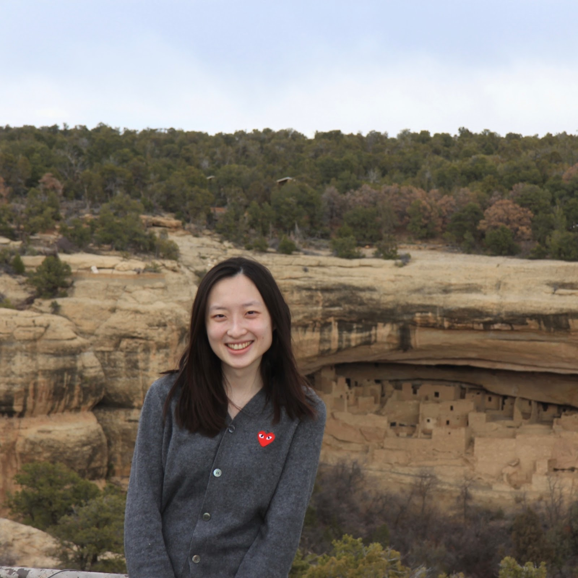

Students Team
Anne Lin
EDA, ML models, Business insights
al4215@columbia.edu
Main point of contact
Mengchen Xu
Java, C++, ML models, info retrieval
mx2257@columbia.edu
Clarissa Tai
Data visualization,
ML models
rt2822@columbia.edu
Yu-Chieh Chen
EDA, scaping, ML models
yc4015@columbia.edu
Yue Zhang
Web, Algorithm, ML models
yz4155@columbia.edu

Slide 4

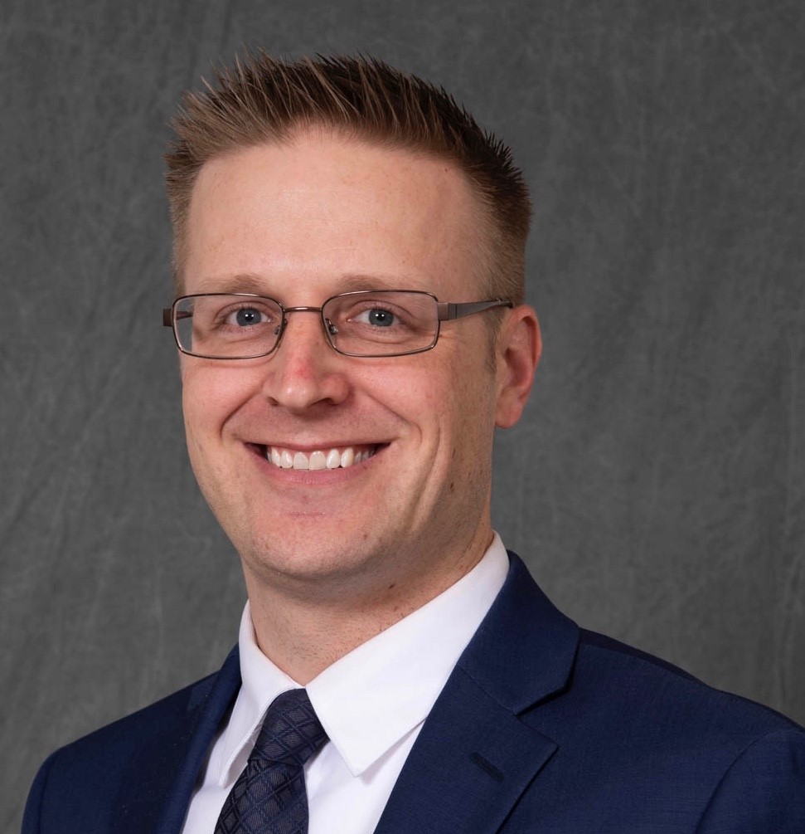
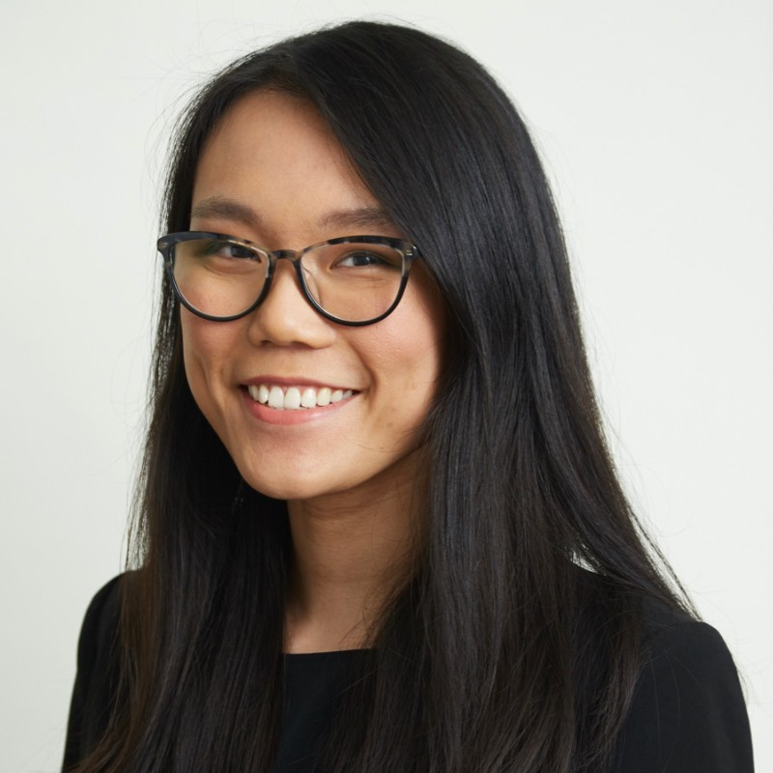
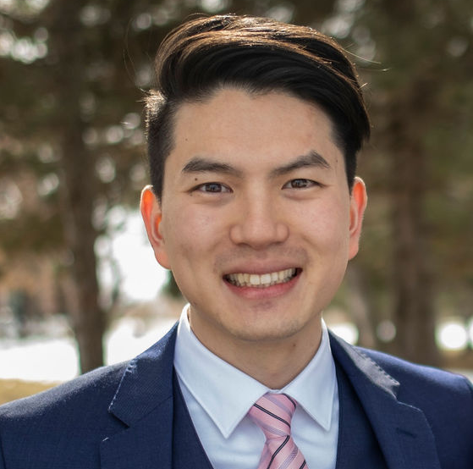
KPMG Mentor Team
Arvind Sathi
Director at KPMG Lighthouse
Advisory Data Organization
asathi@kpmg.com
John Heath
Director at KPMG
Tech Assurance Audit
jaheath@kpmg.com
Michelle Zee
Sr. Associate at KPMG Lighthouse
D&A Consultant
mzee@kpmg.com
Jeffrey Lee
Associate at KPMG Lighthouse D&A Modeler
jeffreylee4@kpmg.com

Slide 5
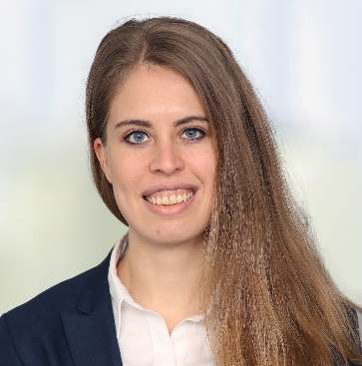
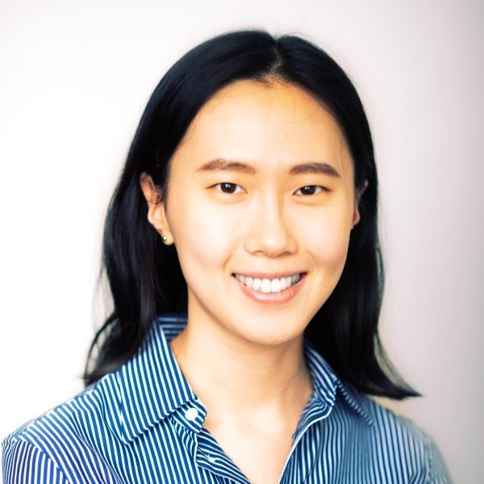
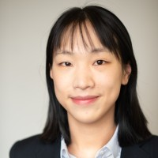
KPMG Supporting Team
Laura Uguccioni
Manager at KPMG Lighthouse D&A Data Scientist
luguccioni@kpmg.com
Sydney (Bolim) Son
Associate at KPMG Lighthouse D&A Data Modeler
sydneyson@kpmg.com
Chengwei Wang
Associate at KPMG Lighthouse D&A Data Scientist
chengweiwang@kpmg.com
Main point of contact

Slide 6










Project Overview
The project aims to develop a model/algorithm to recommend or optimize locations for EV charging stations for a certain area, especially in a rural or hard-to-reach area, using ML, DL, and geospatial models. Afterwards, students will find business application of their model/algorithm created.
EV charging station data + + Traffic data + Community data
Location forecasting model with geospatial analysis, location optimization, ML/DL classifiers
Apply a business case to the model created, such as location recommendation system, location evaluation system...
Subject matter research

Slide 7

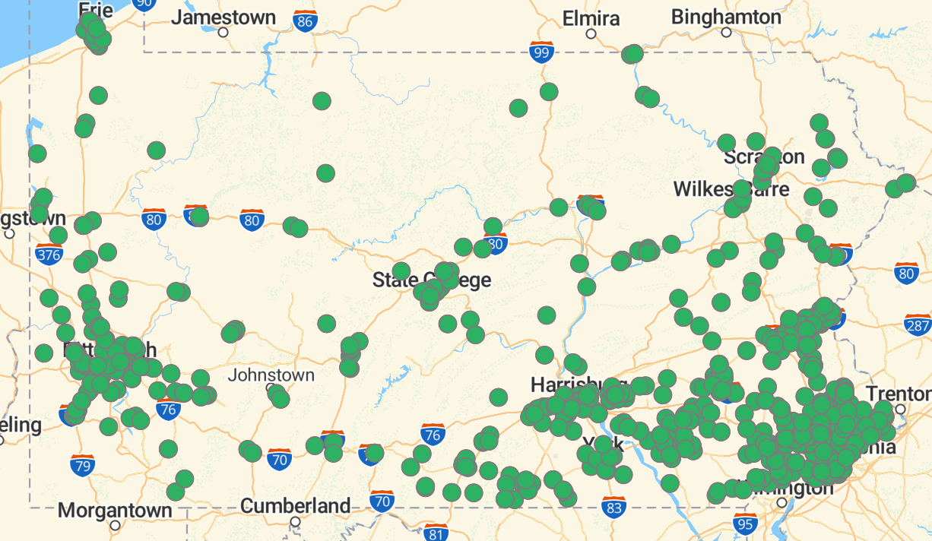

Project Overview Goals and Objectives
We hope this capstone project gives you an on-hands experience on data science supported consulting work. It is not just technology, nor just business, but a combination of the two. We hope that you will be able to learn both technical and business sides of data science consulting.
Technical Side
Business Side
Geospatial analysis, Machine learning / Deep learning, optimization, and more
Business application of machine learning models created, presentation, communication and more

Slide 8
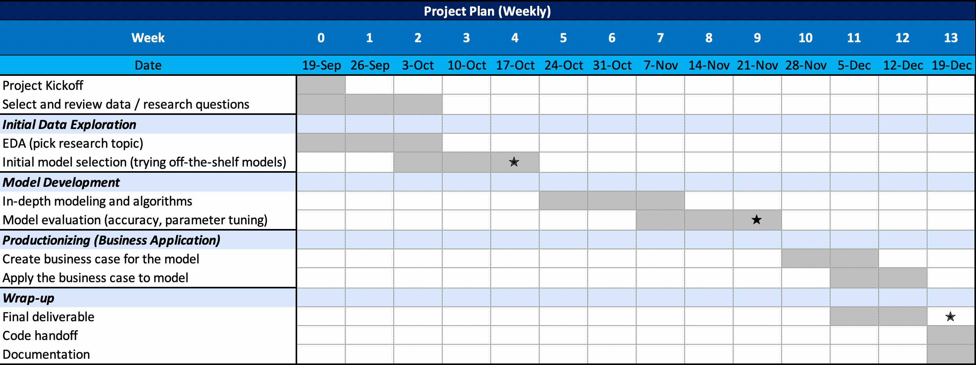
Suggested Timeline
It is a 13-week project with 2 mid-point reviews and a final readout on mid-Dec. Every week, there will be a weekly status update call with KPMG mentors. Details are suggestion, please feel free to edit as you seem fit.

Slide 9
Project Overview - Deliverables
Throughout the project, the students are expected to deliver the below deliverables.
Deliverable name | Content | Format
Weekly status update | A powerpoint deck that has updates on work progress made during the week. Deck to include slides such as the week's agenda, timeline, progress, next steps, and relevant visuals to support. | Powerpoint
Mid-point reviews * 2 | A powerpoint deck that has updates on progress made until mid-way of the project. This deck should discuss where the project lies on the entire project scope. Deck to include slides such as agenda, timeline, progress, next steps, architecture diagram and relevant visuals. | Powerpoint
Final deliverable | A powerpoint deck that has an entire summary of the project with model results, business use cases, and relevant visuals. This deck is a final report deck, that walks through project from start to end, with findings from the project. Deck to include slides such as project introduction, model design/architecture, model selection, data processing, feature engineering /selection, model performance, model validation, business use cases, insights and conclusion. Appendix can be used to include more technical information. | Powerpoint
Code files / Github | Sharing code(s) used for the project. | R or python files
Visualizations | Visualizations to illustrate the model performance, insights, findings etc. A full-stack dashboard is optional. | Any file type

Slide 10
Q&A
If you have any questions, please feel free to let us know!
Weekly calls: TBD. Invitation will be forwarded to students.
Communication:
Student main point of contact: Anne Lin (al4215@columbia.edu)
If you have any questions or other things to discuss, please send email to Chengwei Wang (chengweiwang@kpmg.com)
Action items:
Review the proposal and data directory
Form a clear and focused research question
Select one state to develop solution on
Go over timeline, discuss on action items
If you have questions prior to next meeting, email Chengwei

Slide 11
Appendix

Slide 12
Some or all of the services described herein may not be permissible for KPMG audit clients and their affiliates or related entities.
kpmg.com/socialmedia
The information contained herein is of a general nature and is not intended to address the circumstances of any particular individual or entity. Although we endeavor to provide accurate and timely information, there can be no guarantee that such information is accurate as of the date it is received or that it will continue to be accurate in the future. No one should act upon such information without appropriate professional advice after a thorough examination of the particular situation.
© 2020 KPMG LLP, a Delaware limited liability partnership and the U.S. member firm of the KPMG network of independent member firms affiliated with KPMG International Cooperative (“KPMG International”), a Swiss entity. All rights reserved. NDP112843
The KPMG name and logo are registered trademarks or trademarks of KPMG International.

